Slide 1
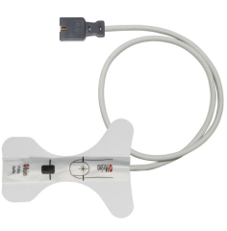
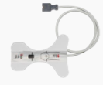
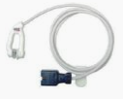
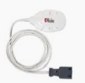
LNCS Single Patient Use SpO2 Sensors
Single Patient Use O2 Sensors: available in RD & LNCS
Single patient use Adult Sensor
Adult >30kg
1859:LNCS Adt
Single patient use Ear Sensor
Ear Clip sits in the ear conch, >30kg
Note: Requires Masimo SET MSLP board, MS-2000 or higher or Rainbow
2918:LNCS E1
Single patient use Paediatric Sensor
Paediatric 10-50kg
1860:LNCS Paediatric
Single patient use Forehead Sensor. TFA-1
Use a headband to keep the cable off the face
Note: Requires Masimo SET MSLP board, MS-2000 or higher or Rainbow
3857:LNCS TFA-1

